Slide 1

MedStream Analytics
Team h83

Slide 2


In today's healthcare industry, one of the most pressing challenges is the significant delay in providing timely patient care and interventions. This issue is primarily attributed to the conventional batch processing approach employed in healthcare analytics. This delay can have severe consequences for patient outcomes, healthcare costs, and overall system efficiency.
Problem Statement

Slide 3



Proposed Solution
MedStream Analytics is an innovative introduce real-time data analytics into the healthcare industry, dramatically reducing latency and enabling timely interventions. By embracing cutting-edge technologies such as Apache Flink, Kafka, and Digital Twins:
It enables seamless and real-time data streaming from medical devices, sensors, and patient records.
It ensures that data flows continuously and reliably to our analytics pipeline.
Apache Flink’s stream processing capabilities allow us to process incoming healthcare data instantly, providing immediate insights.
Digital Twin technology helps us to create virtual representations of healthcare assets.
Simulate real-time data of a Vital Signs Monitor.

Slide 4
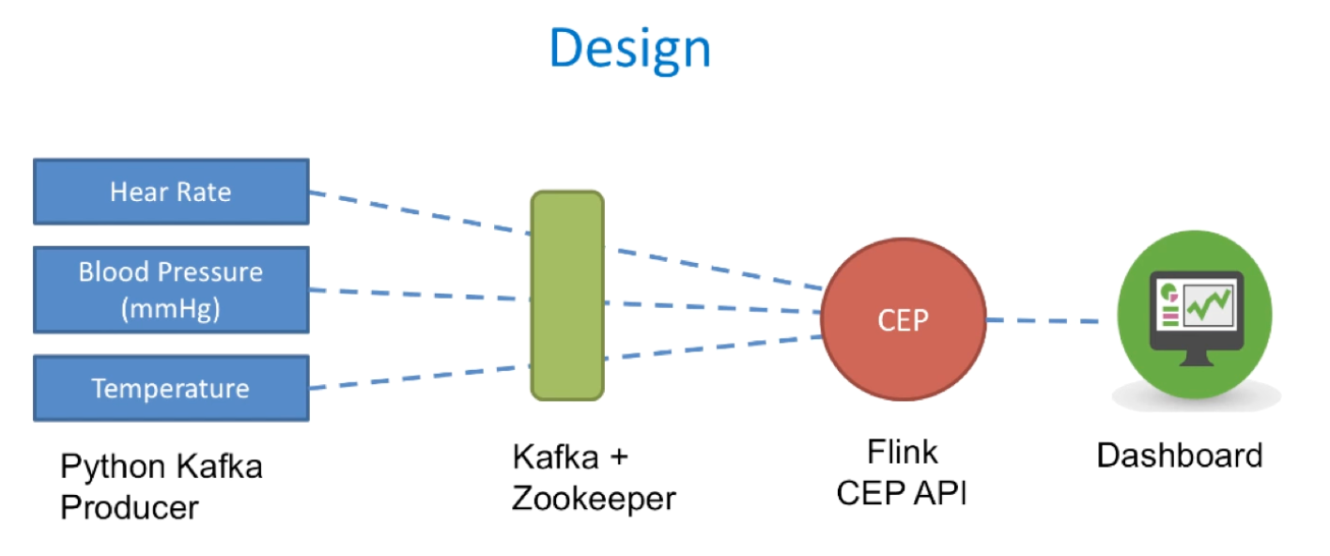
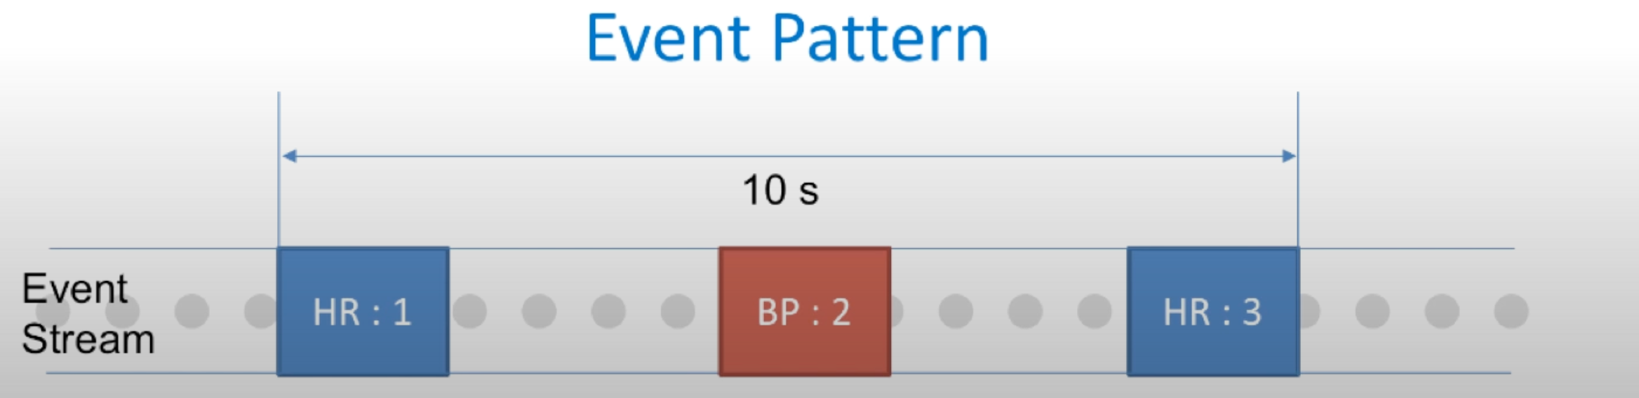

Slide 5
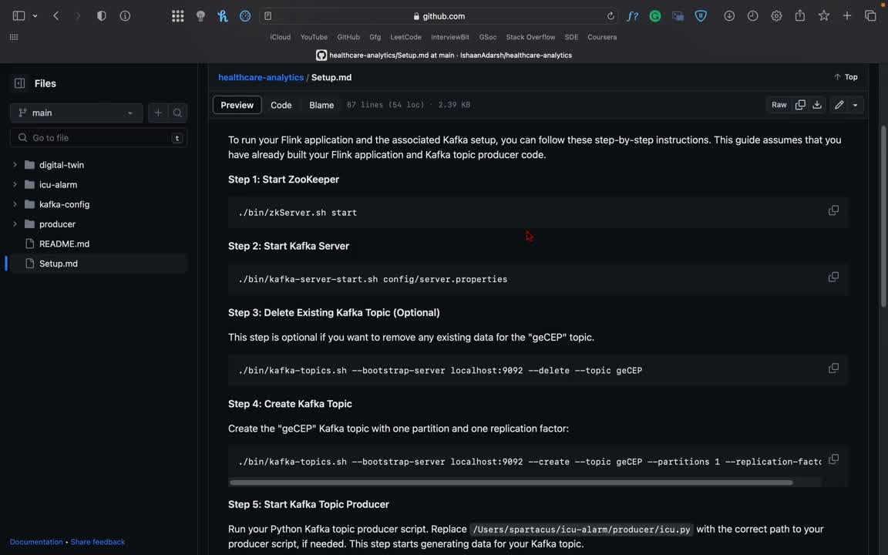
Apache Kafka:
Kafka Topics:
We've set up a Kafka topic named "geCEP," which acts as a data channel. This topic serves as the bridge between data producers and data processors, allowing us to stream healthcare sensor data seamlessly.
Producer Role:
Our Python Kafka producer script plays a vital role. It generates simulated healthcare data and sends it to the Kafka topic "geCEP." This data represents vital signs information such as heart rate, temperature, and blood pressure, mimicking what real medical devices would produce.

Slide 6
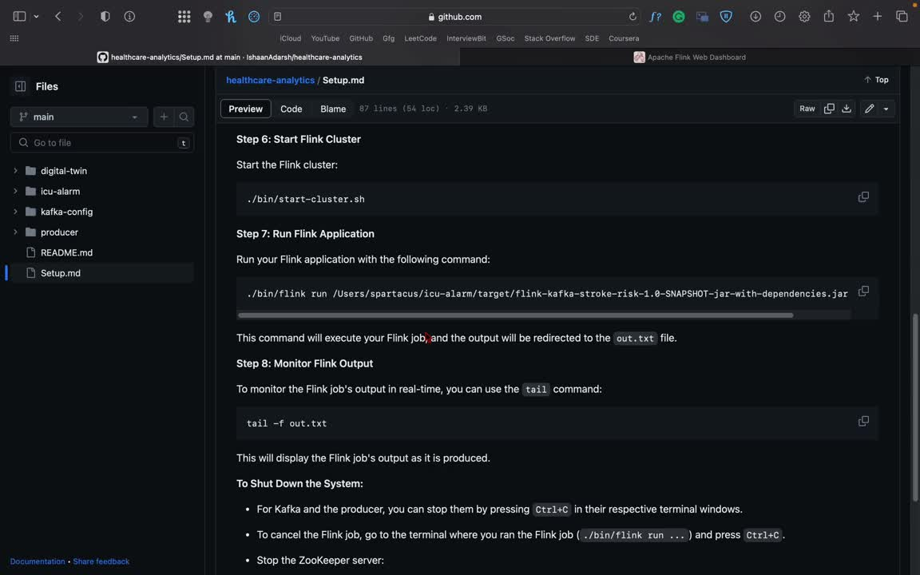
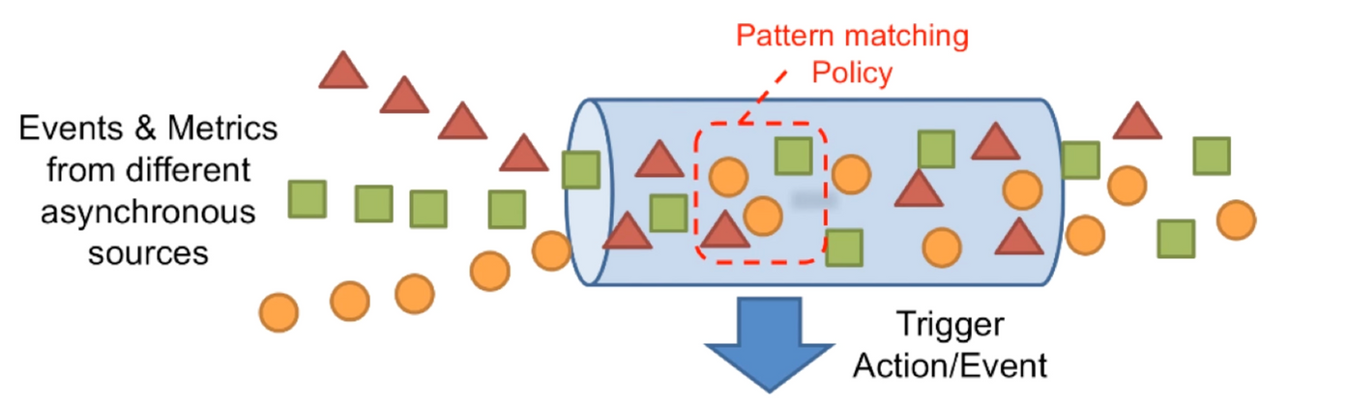
Apache Flink
Real-time Data Processing:
Apache Flink is at the core of our real-time analytics solution. It ingests the continuous stream of healthcare sensor data from the Kafka topic "geCEP" and processes it in real-time. This means that as data arrives, Flink immediately starts analyzing it, eliminating the traditional batch processing latency.
Complex Event Processing (CEP):
Flink's CEP library is employed to define and detect complex patterns and events in the incoming healthcare data stream. For instance, it can detect patterns indicating abnormal vital signs, such as a rapid increase in heart rate or a sudden drop in blood pressure. When such patterns are detected, Flink triggers alerts in real-time.
Medical Journal

Slide 7
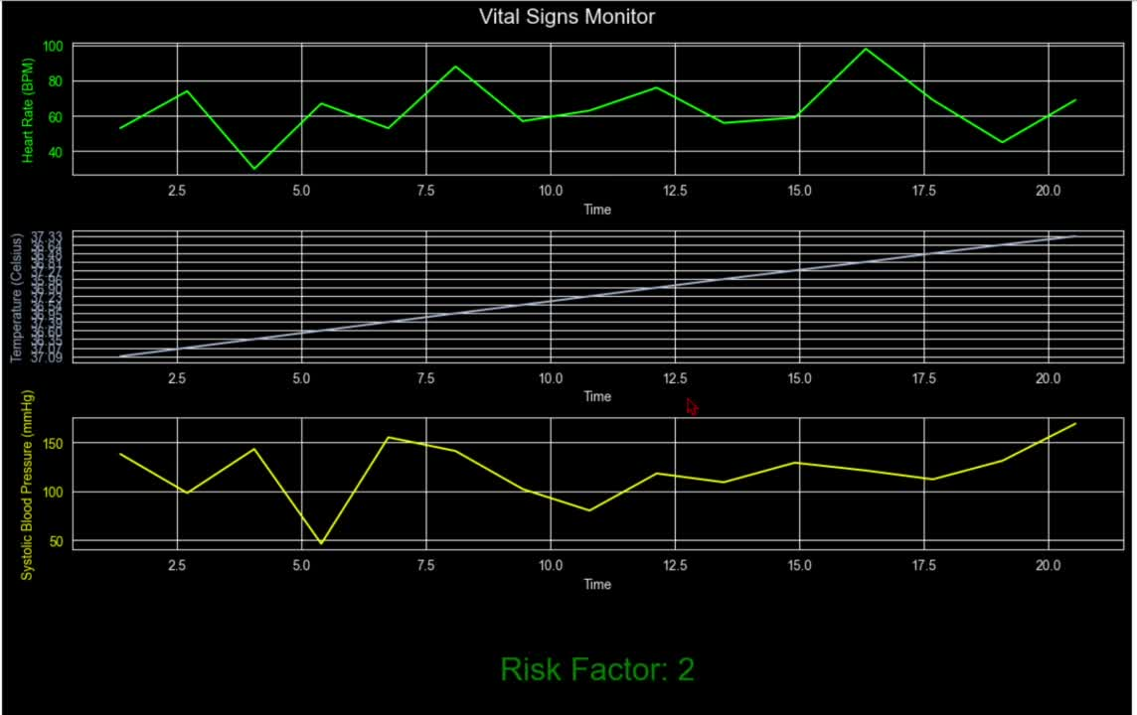
Digital Twin:
Realistic Data Generation:
The Python Digital Twin generates lifelike patient data, simulating variations in vital signs like heart rate, temperature, and blood pressure based on statistical distributions.
Real-Time Alerts:
It continuously monitors vital signs and calculates a "stroke risk factor.” When a failure signature is detected, the Digital Twin triggers alerts via email and SMS in real-time, mirroring how a real device might notify healthcare professionals.
Real-Time Plotting:
The Digital Twin creates real-time plots, allowing us to visualize and respond to changes in the virtual patient's health status.

Slide 8
For Patients:
For Healthcare Providers:
Benefits and Impact
Patients benefit from increased safety and security due to Faster Interventions
Real-Time Alerts
Cost Optimization
Scalability
Cost Optimization:
Resource Efficiency: We have implemented this using Apache Kafka, a highly scalable and fault-tolerant streaming platform, plays a pivotal role in handling large volumes of data efficiently.
Modular Architecture: Our project is built with a modular architecture, making it easier to scale individual components as needed. This flexibility allows healthcare providers to adapt the system to their specific requirements.
Through strategic data filtering and aggregation before processing, we minimize the compute resources required for analysis.
We have optimized our real-time analytics to be cost-effective. By utilizing efficient algorithms and filtering mechanisms, we ensure that the benefits of real-time analysis outweigh the costs.

Slide 9
We thank you for your time and consideration.
Team h83

